Slide 1

Database Concepts
Ninth Edition
Chapter 2
The Relational Model
Copyright © 2020, 2017, 2015 Pearson Education, Inc. All Rights Reserved
Notes:
If this PowerPoint presentation contains mathematical equations, you may need to check that your computer has the following installed:
1) Math Type Plugin
2) Math Player (free versions available)
3) NVDA Reader (free versions available)

Slide 2
Learning Objectives
Learn the conceptual foundation of the relational model
Understand how relations differ from nonrelational tables
Learn basic relational terminology
Learn the meaning and importance of keys, foreign keys, and related terminology
Understand how foreign keys represent relationships
Learn the purpose and use of surrogate keys
Learn the meaning of functional dependencies
Learn to apply a process for normalizing relations

Slide 3
Relational Terms
Learn the conceptual foundation of the relational model
An entity is something of importance to the user that needs to be represented in a database.
In an entity-relationship model (discussed in Chapter 4), entities are restricted to things that can be represented by a single table.
A relation is a two-dimensional table consisting of rows and columns that has the characteristics shown in Figure 2.1 on the next slide.

Slide 4
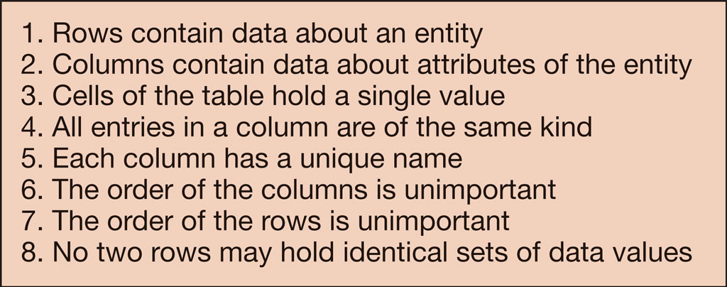
Figure 2.1 Characteristics of a Relation

Slide 5
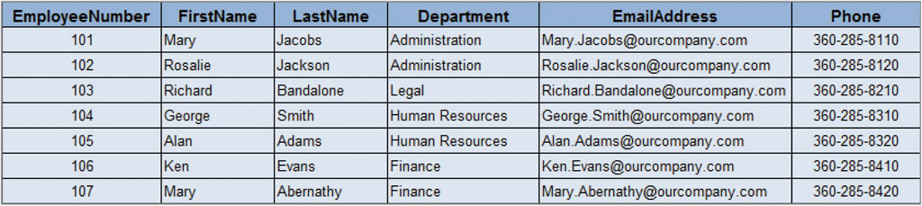
Figure 2.2 Sample EMPLOYEE Relation

Slide 6
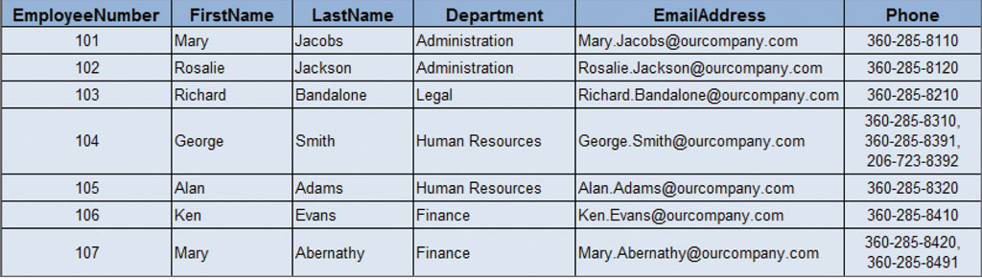
Figure 2.3 Nonrelational Table-Multiple Entries per Cell

Slide 7
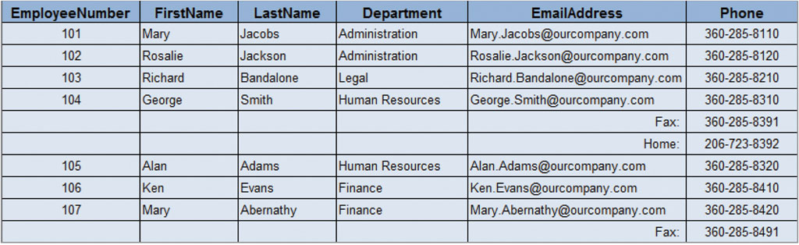
Figure 2.4 Nonrelational Table-Order of Rows Matters and Kind of Column Entries Differs in Email

Slide 8
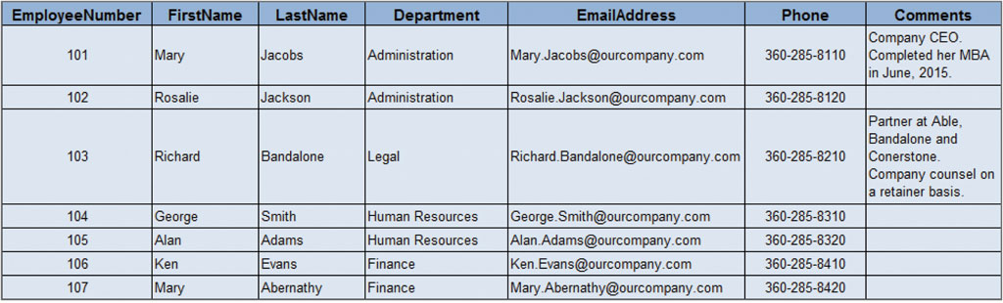
Figure 2.5 Relation with Variable-Length Column Values

Slide 9
Presenting Relation Structures
Learn basic relational terminology
When writing out relation structures use the following format:
Relation names are written first in all caps (if two words then use an underscore between them) and they are always singular.
A column name is written with the first letter capitalized (if two words, then run them together and capitalize the first letter of each word)
A database schema is the design on which a database and its associated applications are built.

Slide 10
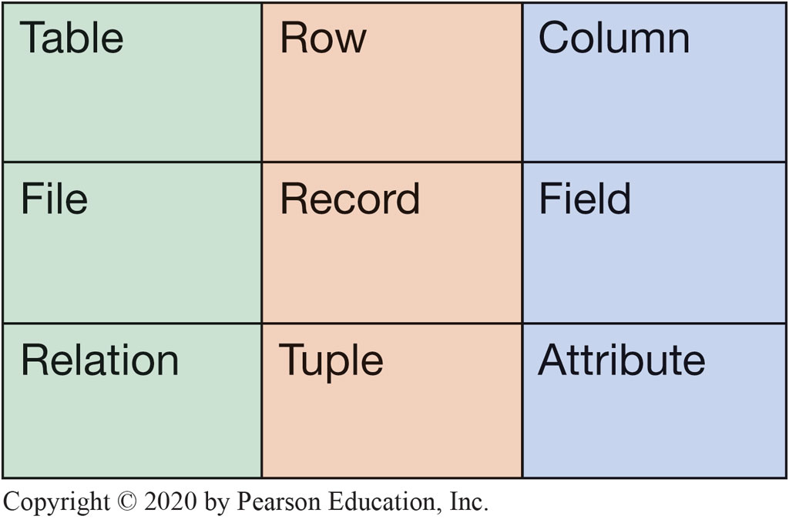
Figure 2.6 Equivalent Sets of Terms

Slide 11
Types of Keys
Learn the meaning and importance of keys, foreign keys, and related terminology
A key is one or more columns of a relation that is used to identify a row.
A key can be unique (primary key) or nonunique (foreign key)
A composite key contains two or more attributes.
Candidate keys are keys that uniquely identify each row in a relation.
A primary key is a candidate key that is chosen as the key that the D M B S will use to uniquely identify each row in a relation.
The primary key in a relation will be underlined.

Slide 12
Example of a Relation
Learn the meaning and importance of keys, foreign keys, and related terminology
Consider the following example of a relation:
EMPLOYEE (EmployeeNumber, FirstName, LastName, Department, EmailAddress, Phone)
Notice the following in the example above:
The relation is in all caps
All the attributes are within parentheses
The primary key consists of two words run together with the first letter of each word capitalized. It is also underlined.

Slide 13
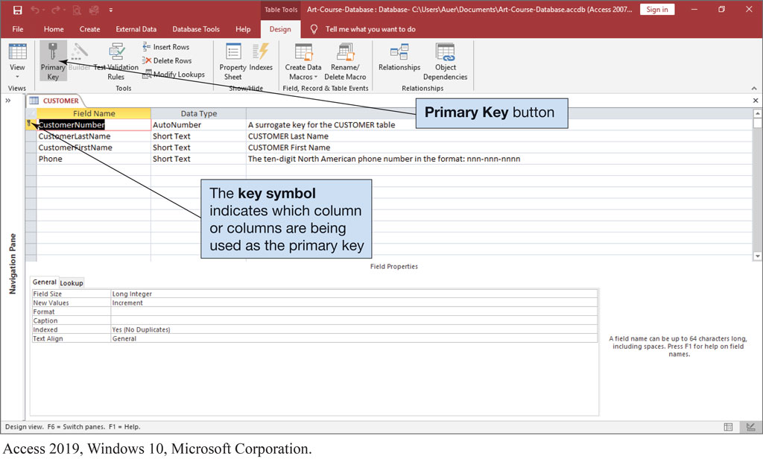
Figure 2.7 Defining a Primary Key in Microsoft Access 2019
Access 2019, Windows 10, Microsoft Corporation

Slide 14
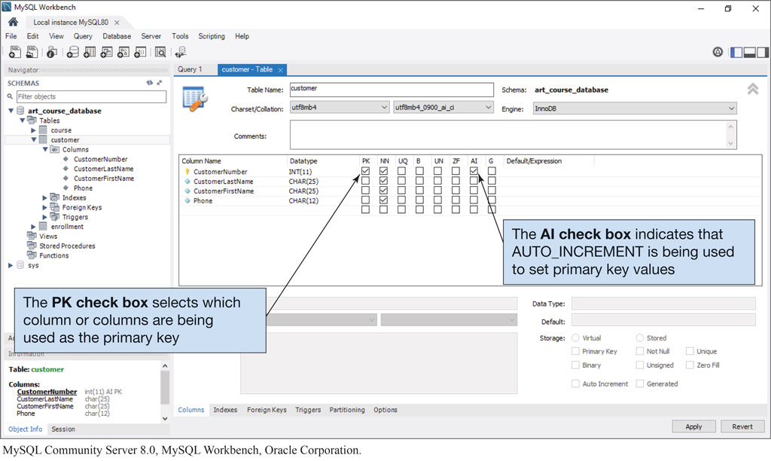
Figure 2.8 Defining a Primary Key in MyS Q L 8.0
MyS Q L Community Server 8.0, MyS Q L Workbench, Oracle Corporation

Slide 15
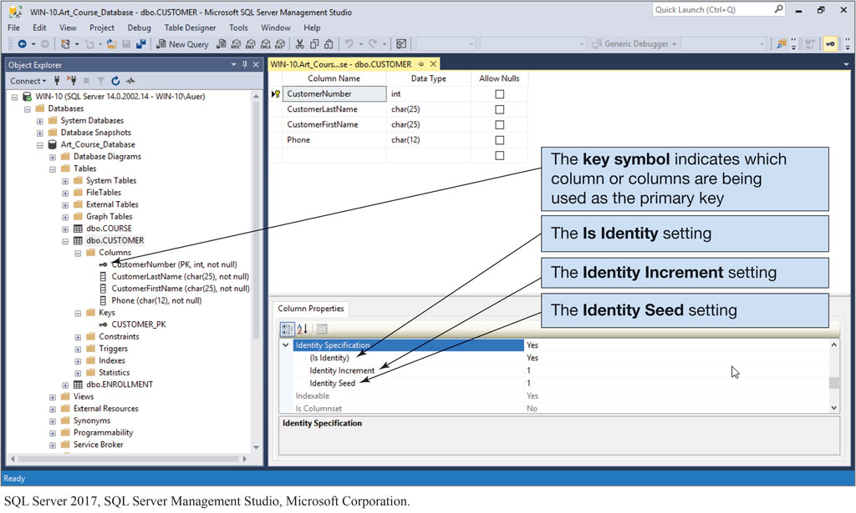
Figure 2.9 Defining a Key in Microsoft S Q L Server 2017
S Q L Server 2017, S Q L Server Management Studio, Microsoft Corporation

Slide 16
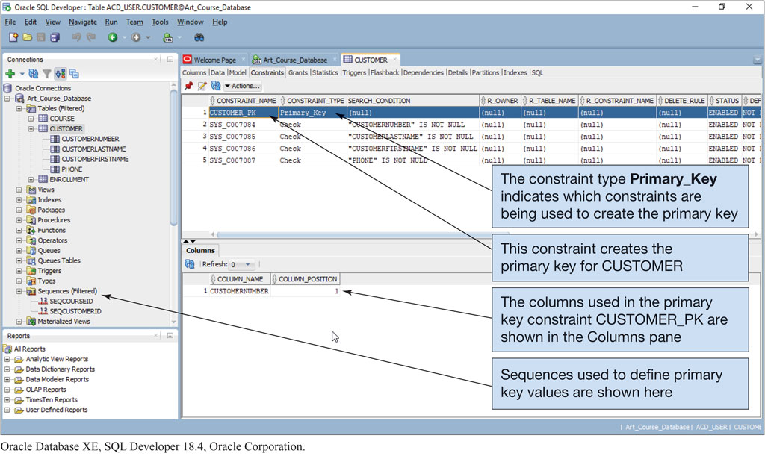
Figure 2.10 Defining a Primary Key in Oracle Database X E
Oracle Database X E, S Q L Developer 18.4, Oracle Corporation

Slide 17
Surrogate Keys
Learn the purpose and use of surrogate keys
A surrogate key is a column with a unique, D B M S-assigned identifier that has been added to a table to be the primary key.
The ideal surrogate key is short, numeric and never changes.
Suppose we have the following table:
PROPERTY (Street, City, State, ZIP, OwnerI D)
Notice that it takes the street, city, state, and zip to uniquely identify a row in a table.
Now lets use a surrogate key as a unique identifier!
PROPERTY (PropertyID, Street, City, State, ZIP, OwnerI D)

Slide 18
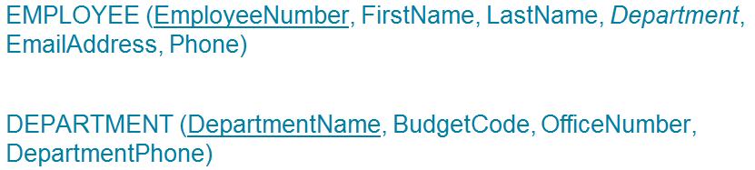
Foreign Keys
Learn how foreign keys represent relationships
A foreign key is a primary key of another relation that has been placed in the current relation to represent a relationship between two tables.
It is represented in a relation by italics as seen in the example below.

Slide 19
Referential Integrity
Understand how foreign keys represent relationships
A referential integrity constraint states that every value of a foreign key must match a value of an existing primary key.
In the relationship between EMPLOYEE and DEPARTMENT seen on the previous slide, the department attribute located in the EMPLOYEE table is the foreign key and whatever value is placed in that column, the same value MUST exist in the Department attribute in the DEPARTMENT table.

Slide 20
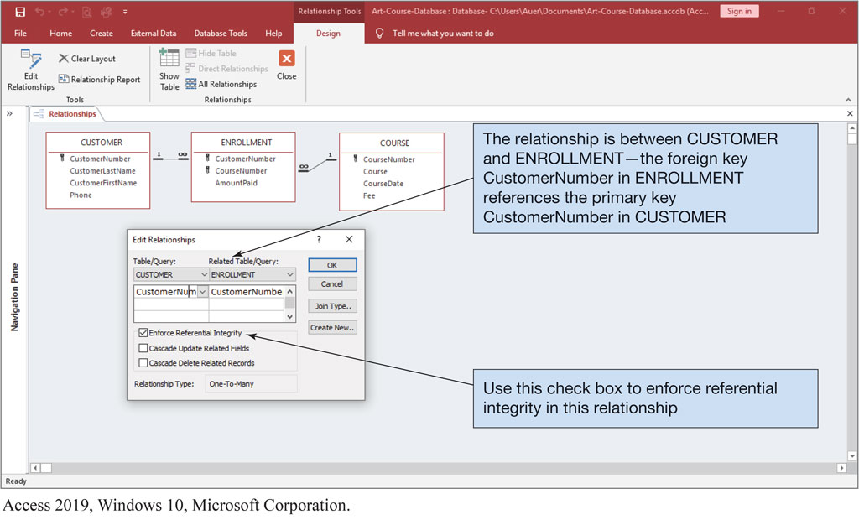
Figure 2.11 Enforcing Referential Integrity in Microsoft Access 2019
Access 2019, Windows 10, Microsoft Corporation

Slide 21
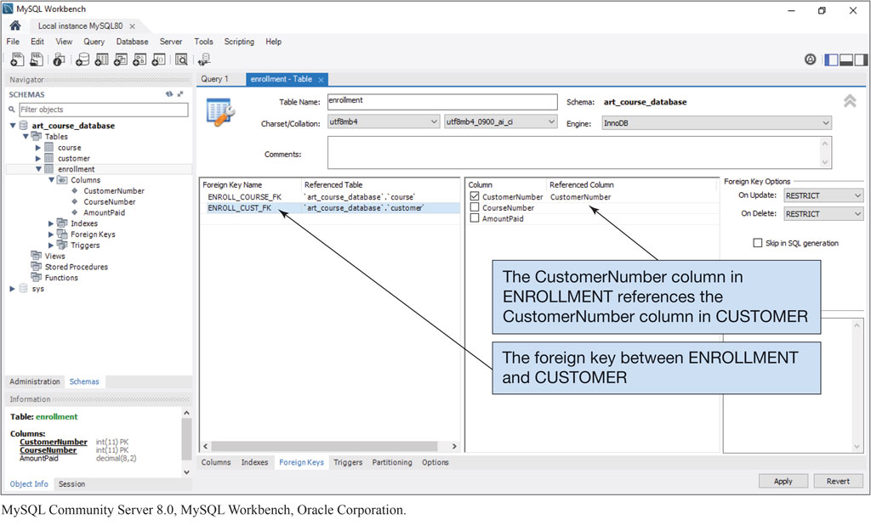
Figure 2.12 Enforcing Referential Integrity in MyS Q L 8.0
MyS Q L Community Server 8.0, MyS Q L Workbench, Oracle Corporation

Slide 22
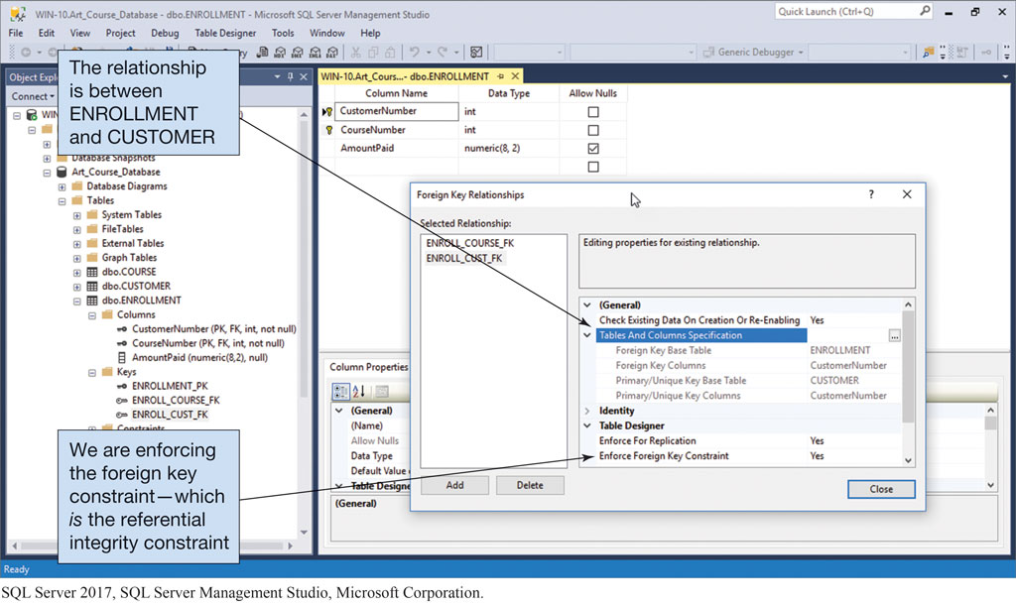
Figure 2.13 Enforcing Referential Integrity in Microsoft S Q L Server 2017
S Q L Server 2017, S Q L Server Management Studio, Microsoft Corporation

Slide 23
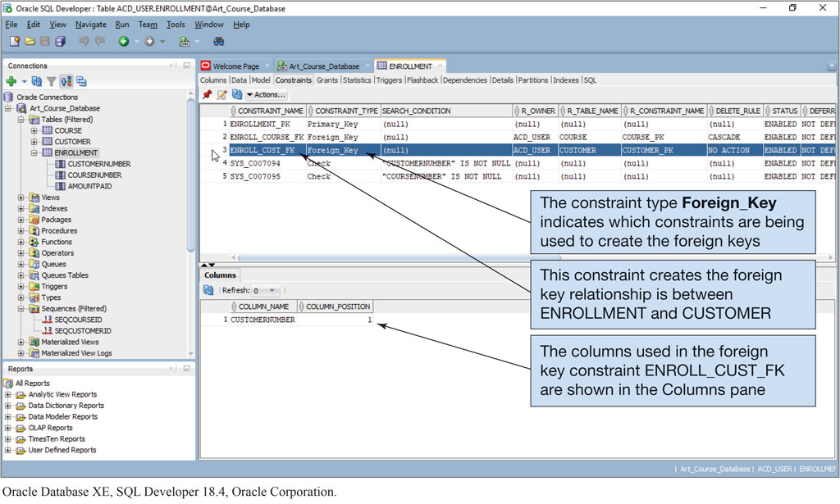
Figure 2.14 Enforcing Referential Integrity in Oracle Database X E
Oracle Database X E, S Q L Developer 18.4, Oracle Corporation

Slide 24
The NULL Value
Learn the meaning and importance of keys, foreign keys, and related terminology
A null value is a missing value in a cell in a relation.
The problem with null values is that it is ambiguous:
Is it that no value is appropriate,
Is it known, but not entered, or
Is it unknown, thus not entered.
You can eliminate null values by requiring an attribute value.

Slide 25
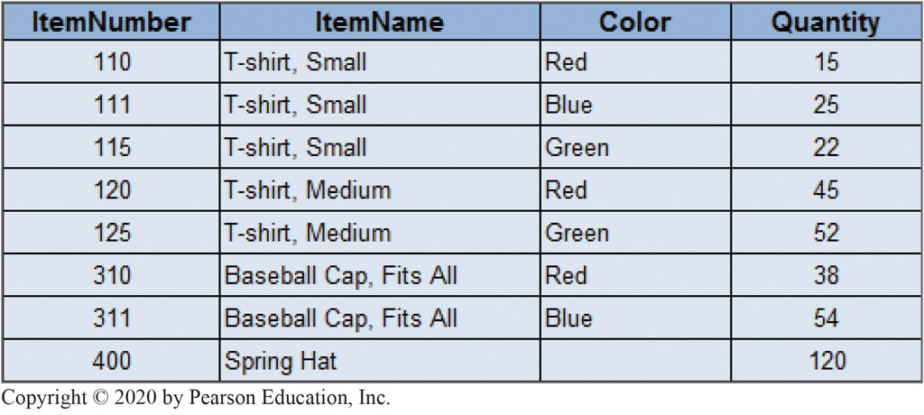
Figure 2.15 Sample ITEM Relation and Data

Slide 26
Functional Dependencies
Learn the meaning of functional dependencies
A functional dependency occurs when a candidate key determines all the other attributes in a relation.
In other words, all the attributes in a relation is functionally dependent on the candidate key.
A dependency is shown with the determinant on the left and then an arrow showing the attribute(s) that depend on it, as shown below.

Slide 27
Normalization
Learn to apply a process for normalizing relations
Normalization is the process of (or set of steps for) breaking a table or relation with more than one theme into a set of tables such that each has only one theme.
Relational design principles for a well-formed relation:
Every determinate must be a candidate key
Any relation that is not well formed should be broken into two or more relations that are well formed
A relation is in first normal form (1 N F) if it:
Has characteristics listed in Figure 2.1
Has a defined primary key
No repeating groups

Slide 28
Normalization Process
Learn to apply a process for normalizing relations
Steps in the normalization process are as follows:
Identify all the candidate keys of the relation.
Identify all the functional dependencies in the relation.
Examine the determinants of the functional dependencies. If any determinant is not a candidate key, the relation is not well formed. In this case:
Place the columns of the functional dependency in a new relation of their own.
Make the determinant of the functional dependency the primary key of the new relation.
Leave a copy of the determinant as a foreign key in the original relation.
Create a referential integrity constraint between the original and the new relation.
Repeat Step 3 until every determinant of every relation is a candidate key.

Slide 29
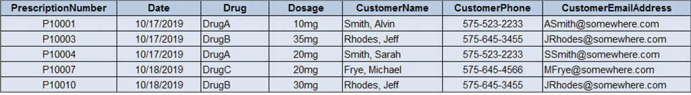
Figure 2.17 Sample PRESCRIPTION Relation and Data

Slide 30
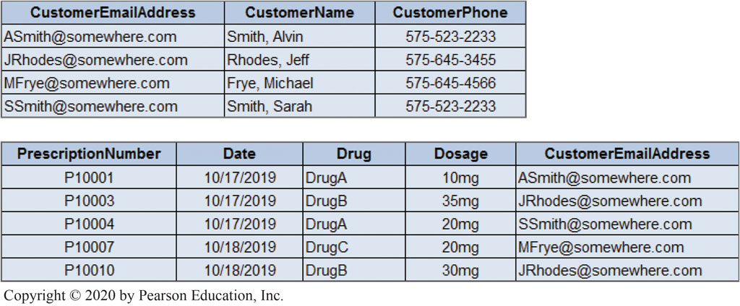
Figure 2.18 Normalized CUSTOMER and PRESCRIPTION Relations and Data

Slide 31
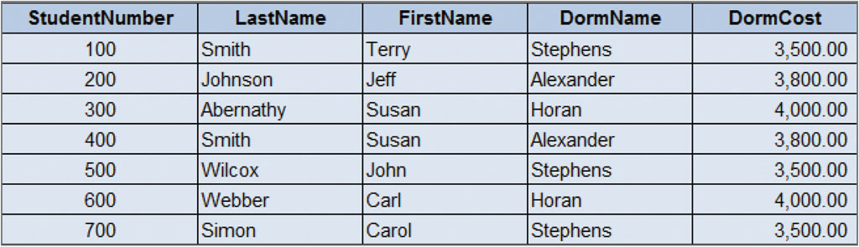
Figure 2.19 Sample S T U_D O R M Relation and Data

Slide 32
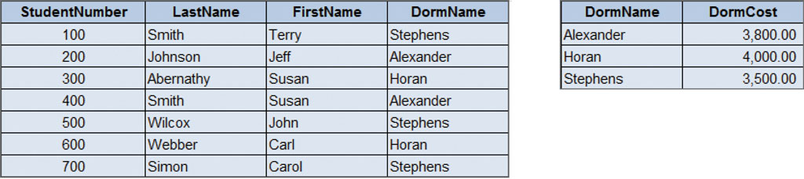
Figure 2.20 Normalized S T U_D O R M and D O R M Relations and Data

Slide 33
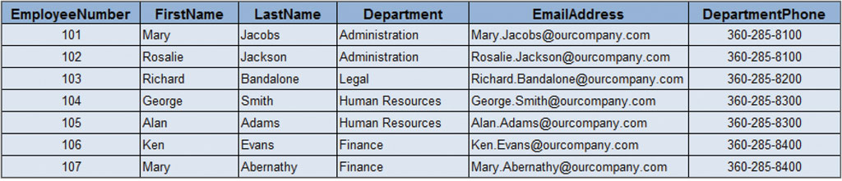
Figure 2.21 Sample EMPLOYEE Relation and Data

Slide 34
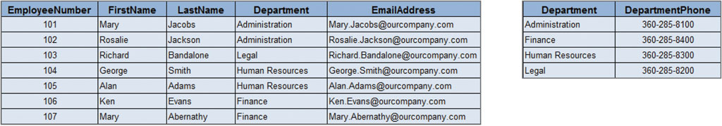
Figure 2.22 Normalized EMPLYEE and DEPARTMENT Relations and Data

Slide 35
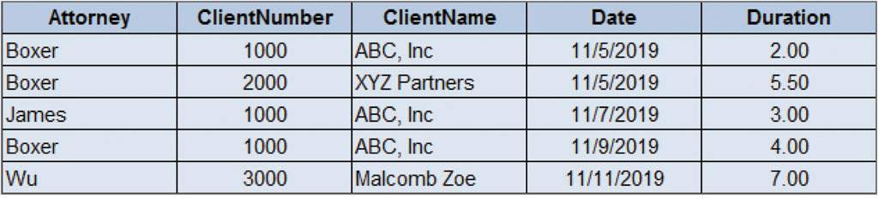
Figure 2.23 Sample MEETING Relation and Data

Slide 36
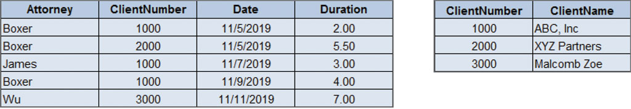
Figure 2.24 Normalized MEETING and CLIENT Relations and Data

Slide 37

Eliminating Anomalies from Multivalued Dependencies
Learn to apply a process for normalizing relations
When modification problems are due to functional dependencies and we then normalize relations to B C N F, we eliminate these anomalies.
Anomalies can also arise from another kind of dependency—the multivalued dependency.
A multivalued dependency occurs when a determinant is matched with a particular set of values as seen below.

Slide 38
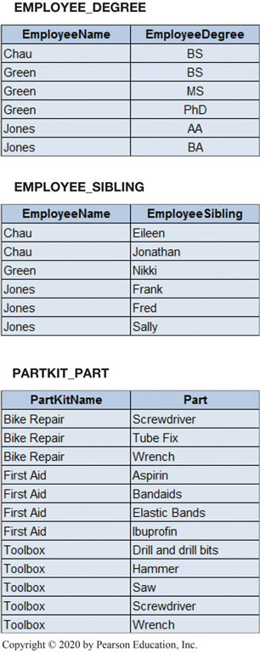
Figure 2.25 Examples of Multivalued Dependencies

Slide 39
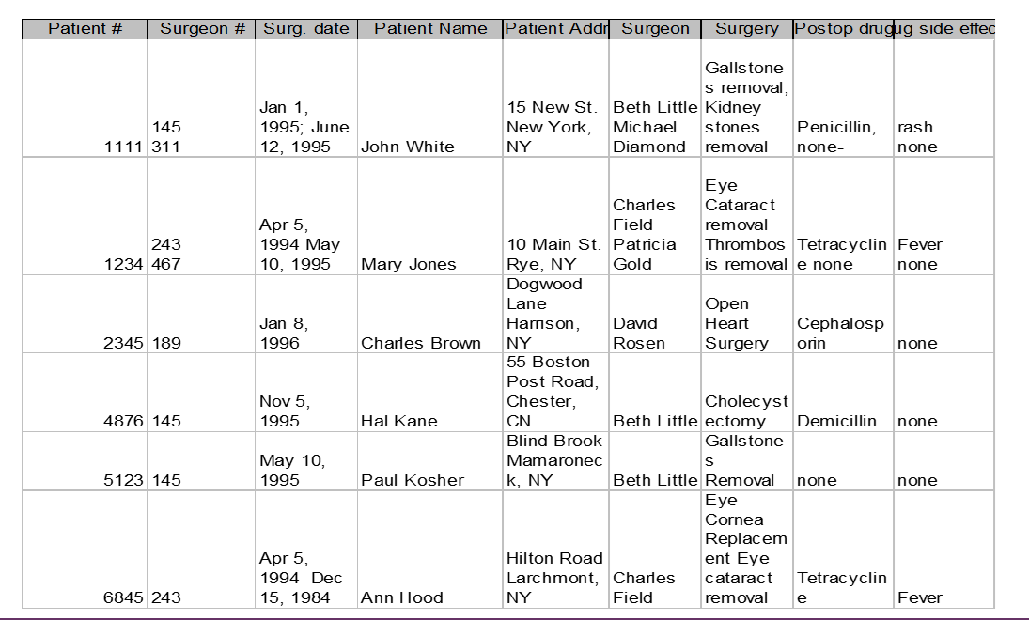
A relation that is not normalized

Slide 40
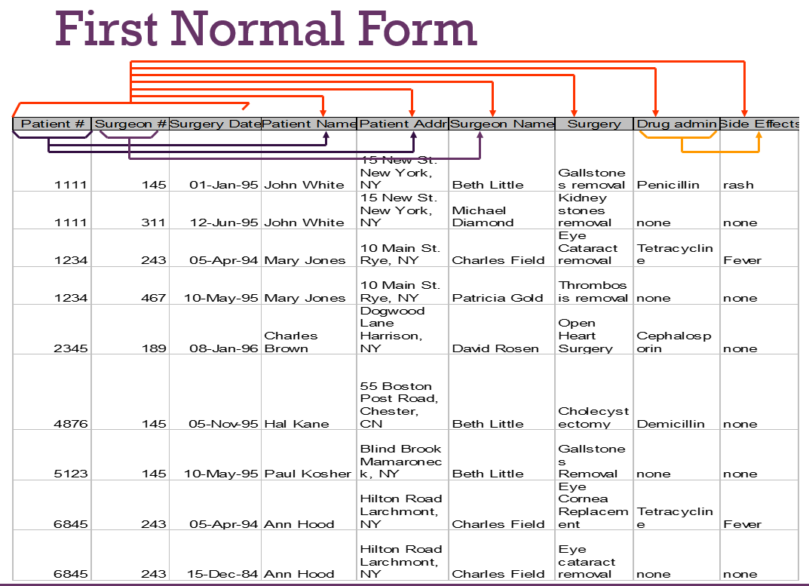
First Normal Form
First Normal Form (1 N F)
each cell has only one value, and all entries in a column are of the same kind

Slide 41
Second Normal Form
Each table is in 1 N F and all non-key attributes are determined by the entire primary key
usually used in tables with a multiple-field primary key (composite key)
each non-key field relates to the entire primary key
any field that does not relate to the primary key is placed in a separate table
MAIN POINT –
eliminate redundant data in a table
Create separate tables for sets of values that apply to multiple records

Slide 42
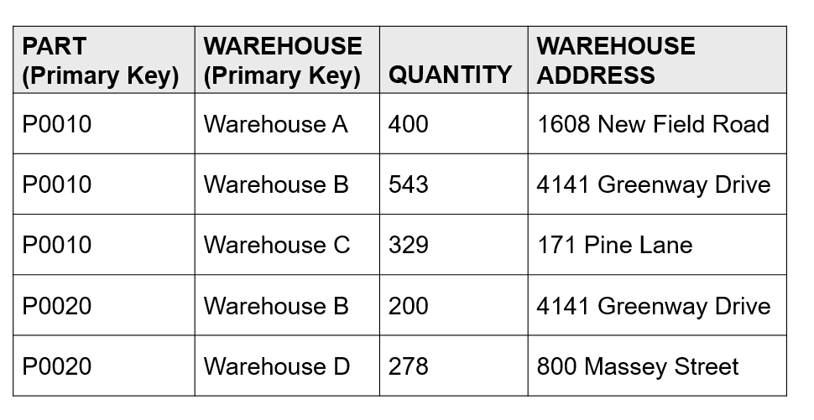
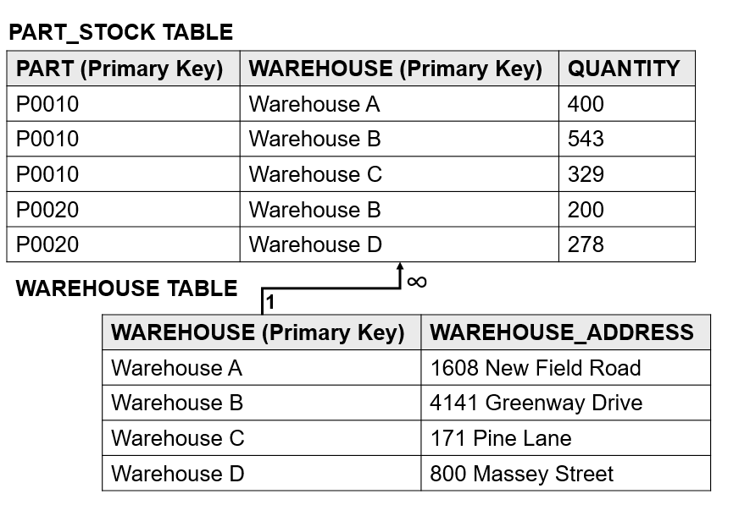
Example:

Slide 43
3rd Normal Form
Third Normal Form (3 N F)
each table is in 2 N F and no non-key attributes are determined by another non-key attribute

Slide 44
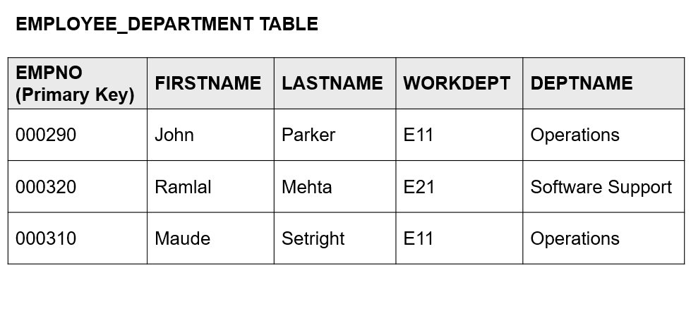
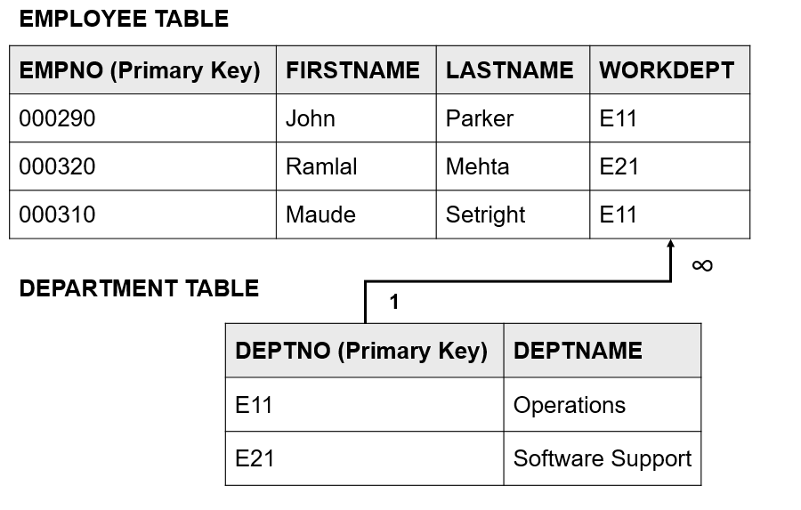
Example:

Slide 45
Boyce-Codd Normal Form
each table is in 3 N F and all determinants are candidate keys.
Most 3NF relations are also BCNF relations.
A 3NF relation is NOT in BCNF if:
Candidate keys in the relation are composite keys (they are not single attributes)
There is more than one candidate key in the relation, and
The keys are not disjoint, that is, some attributes in the keys are common
A table is in Boyce-Codd normal form (BCNF) if every determinant in the table is a candidate key.
(A determinant is any attribute whose value determines other values with a row.)
If a table contains only one candidate key, the 3NF and the BCNF are equivalent.
BCNF is a special case of 3NF

Slide 46
Exercises: Normalize the following table up to 3rd Normal form
Grade (ClassName, Section, Term, Grade, StudentNumber, StudentName, ProfessorName, Department, ProfessorEmailAddress)

Slide 47
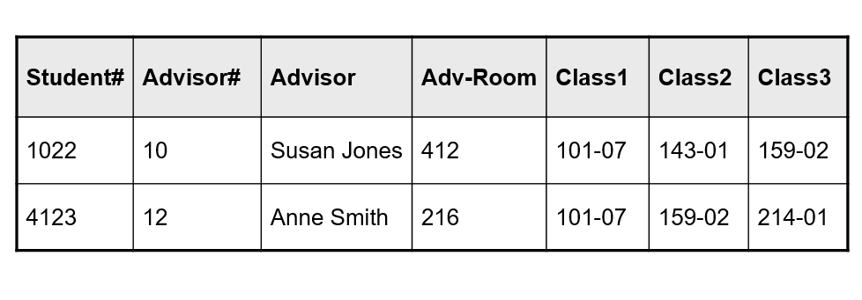
Exercises: Normalize the following tables up to the Third normal form

Slide 48
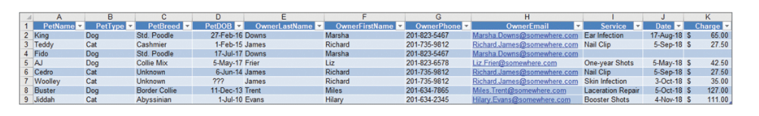
Exercises: Normalize the following tables up to the Third normal form

Slide 49

Copyright
This work is protected by United States copyright laws and is provided solely for the use of instructors in teaching their courses and assessing student learning. Dissemination or sale of any part of this work (including on the World Wide Web) will destroy the integrity of the work and is not permitted. The work and materials from it should never be made available to students except by instructors using the accompanying text in their classes. All recipients of this work are expected to abide by these restrictions and to honor the intended pedagogical purposes and the needs of other instructors who rely on these materials.
Notes:
If this slide was not included in the original PPT, it should be added.

